Slide 1
Recitation #1
17-356/17-766

Slide 2
TAs
Mehul Agarwal
email: mehula@andrew.cmu.edu
office hours: TBD
Rohit Shreenivas
email: rshreeni@andrew.cmu.edu
office hours: TBD

Slide 3
User Stories
The general criteria for a user story:
Capture a description of a software feature from an end-user perspective
Are used for planning
Facilitate conversation among users, stakeholders, developers and etc.

Slide 4
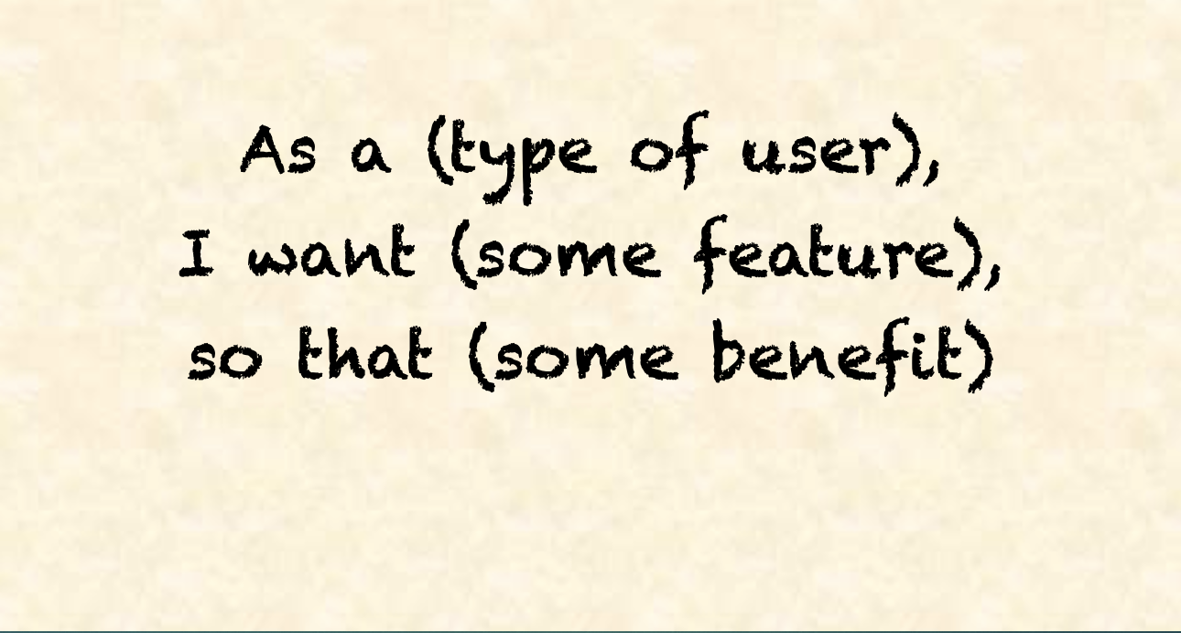
User Story Template

Slide 5
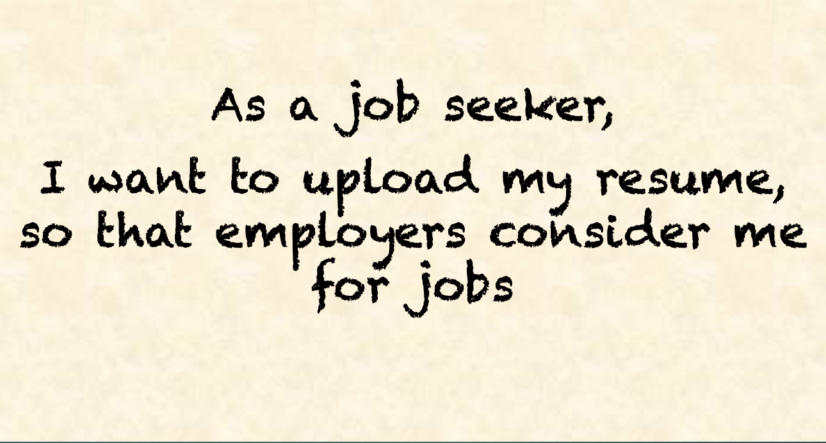
For example, for a job portal:

Slide 6
Epics V/S User Stories
An epic is a large body of work that can be broken down into a number of smaller stories.
Epics often encompass multiple teams, on multiple projects, and can even be tracked on multiple boards.
Epics are almost always delivered over a set of sprints.

Slide 7
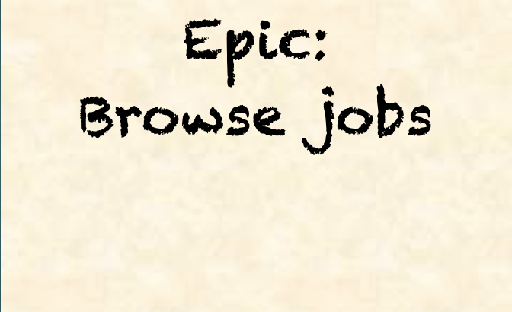
For example, for the same job portal, this could be one of the epics

Slide 8
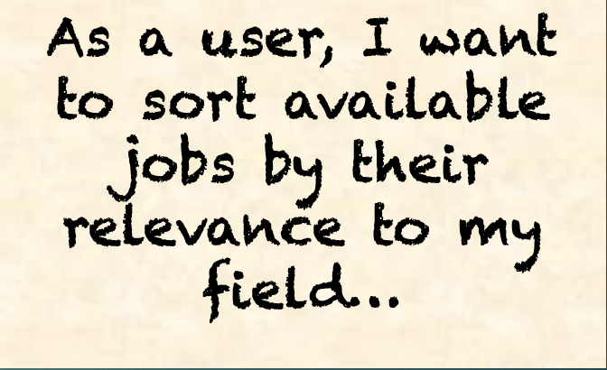
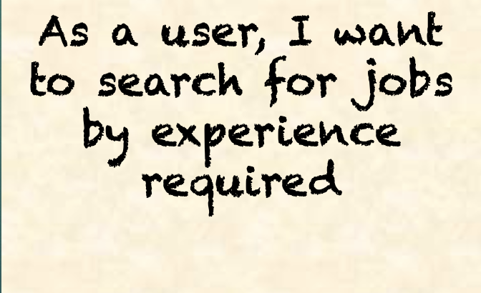
As compared to the User Stories like these

Slide 9
What makes a good user story?
The INVEST principle:
INDEPENDENT
NEGOTIABLE
VALUABLE
ESTIMABLE
SMALL
TESTABLE

Slide 10
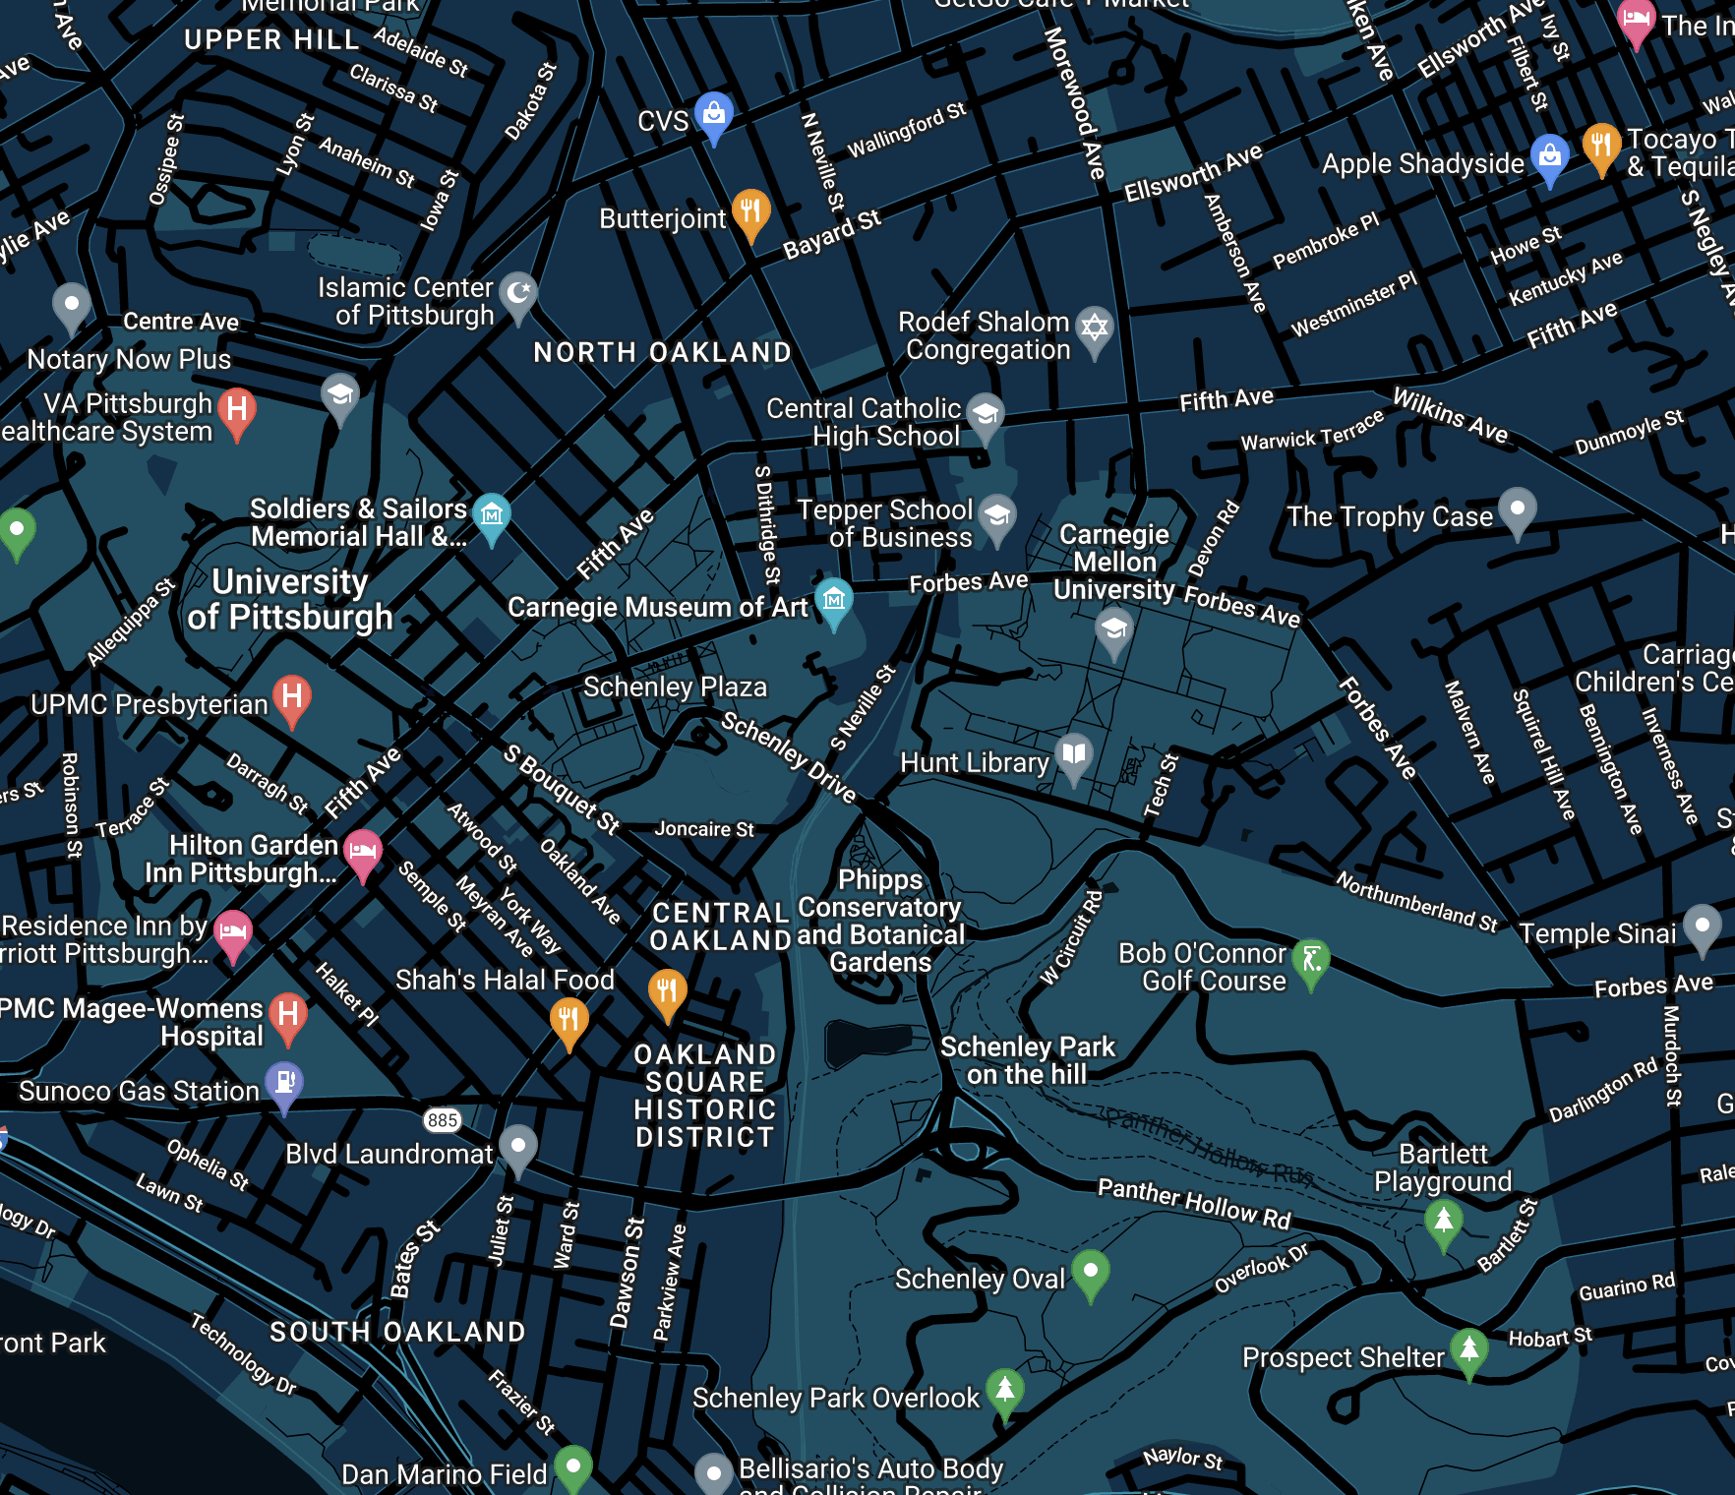
Case Study
Form teams and create User Stories for a product that is Google Maps alternative. For example: “As a delivery driver I would like to be able to have multiple destinations so that I can maximize tips by doing multiple deliveries as fast as possible”

Slide 11
The 3C's Approach
Card: The user stories written on cards by customer/product owner
Conversation: The communication between customer/product owner and developers
Confirmation: Acceptance criteria/test

Slide 12
Let’s try it out!
Capture a description of a software feature from an end-user perspective
(As a class) Let’s come up with a small example application
Same teams, Brainstorm and write 5-10 user stories

Slide 13
Food for thought
What are the benefits of INVEST?
What are the issues with the INVEST approach?

Slide 14
Brass Tacks
Homework 1 available on the course website now!

